Slide 1
COS70006
OOP
Introduction to Object Programming -
First steps at designing a Class
Notes:
SDJ Lecture 4 : Objects_Intro_pt1
© Swinburne or © Pearson Education, IncA Bayley
A Bayley

Slide 2
Objects are often used to model the real-world entities that you find in everyday life.

Slide 3






Real World Entities (Objects)

Slide 4
Step 1, decide what objects we want / need in our program

Slide 5
Objects
know things
& do things

Slide 6
Step 2, identify the things an object knows and the things an object will do
Note: The things an object will do should relate to what it knows.

Slide 7
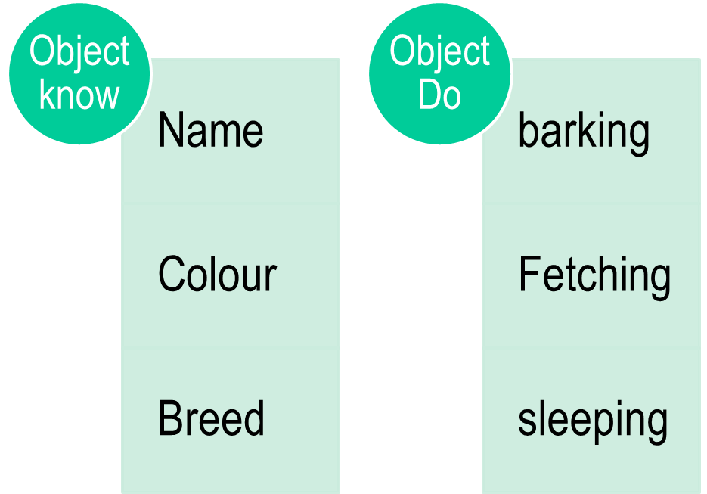

Slide 8
Step 3, Write a specification for each Object.
Objects are specified by classes. So what is a class?
Notes:
Objects are specified by classes. So what is a class?
SDJ Lecture 4 : Objects_Intro_pt1
© Swinburne or © Pearson Education, IncA Bayley

Slide 9
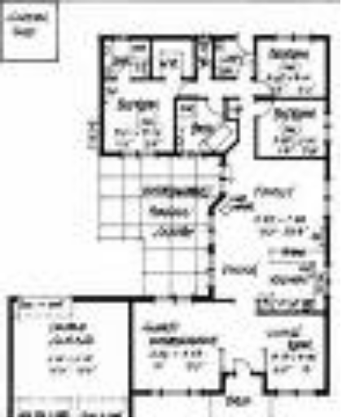
What is class?
A class is a blueprint or prototype from which objects are created.
It is a specification of an object.
Classes specify:
  What an object will know (attributes) - Represented by variables
  What an object will do (Behaviors) - Represented by methods
Creating an object from a class is called “Instantiation”
The specification should as far as practical be language neutral
Jhon’s Account
Class
Bank Account
Instantiation
Objects (Instances)
Sam’s Account

Slide 10
How do we design classes?
UML, will be used to design the class.
What is UML?
Unified Modelling Language
We use UML as an effective tool and industry standard to create a specification for a system
UML class diagrams allow us to denote the contents of classes and the relationships between them.

Slide 11
UML notation
Objects
Class
Account
-owner: String
-amount: double
+getBalance(): double
+credit(): int
+debit(): int
JhonAccount: Account
-owner=“Jhon”
-amount=5000.00
Attributes (Variables)
SamAccount: Account
-owner=“Sam”
-amount=7000.00
Operations (methods)
Notes:
SDJ Lecture 4 : Objects_Intro_pt1
© Swinburne or © Pearson Education, IncA Bayley

Slide 12
After the class has been specified we need to make a code version of this class.
There are multiple OOP languages we could use
Since we are using “Java”
  We need to learn about
    the basic elements of the language
    the syntax for defining a class

Slide 13
Step 4, code the Class
Note: Code that follows the java language rules can be written in Notepad and compiled at a command line.
but
It is far better to use an IDE.
  In this unit we will use BlueJ
  BlueJ

Slide 14


BlueJ
A simple IDE for learning about Java objects
  icons for classes
  icons for objects
  right-click to instantiate, call methods, inspect attribute values, etc
  good editor, debugger, testing tools
Projects and directories
  Like most IDEs a BlueJ project occupies a subdirectory
  but, simpler as no sub-directories (by default)
  Much easier
Right-click to see inside, Inspect.

Slide 15
After competing the design it needs to be tested.
Step 5, build objects based on the class
Step 6, run tests on the object

Slide 16
To summarize
Step 1, decide what objects we want / need in our program
Step 2, identify the things an object knows and the things an object will do
Step 3, Write a specification for each Object
Step 4, code the Class in the chosen OO language
Step 5, build objects based on the class
Step 6, run tests on the object

Slide 17
Let’s now look at the basic elements of Java to create classes

Slide 18
OO Programming Concepts
A system is viewed as a collection of objects.
In order to develop a system we must identify the objects in the system, and hence the classes
Objects have
  data (attributes)
  behaviour (operations)
Objects collaborate with each other to accomplish programming tasks
Users interact with objects
A form is an object
Notes:
SDJ Lecture 4 : Objects_Intro_pt1
© Swinburne or © Pearson Education, IncA Bayley
A Bayley

Slide 19
Recap – the design process

Slide 20
Our task is to choose an object from the real world to model
Before we touch the IDE we need to do a design on paper ( or using a tool e.g. visio)
Ask questions…
  What am I building (Choose a descriptive class name)
  What will it know (object knowledge)? (The data & the type of the data)
    Put the selected attributes in a class diagram
  What will it do, the methods (Work with the data)
    Put the identified operations in the class diagram

Slide 21
UML notation
Objects
Class
Account
-owner: String
-amount: double
+getBalance(): double
+credit(): int
+debit(): int
JhonAccount: Account
-owner=“Jhon”
-amount=5000.00
Attributes (Variables)
SamAccount: Account
-owner=“Sam”
-amount=7000.00
Operations (methods)
Notes:
SDJ Lecture 4 : Objects_Intro_pt1
© Swinburne or © Pearson Education, IncA Bayley

Slide 22
Turning attributes into variables
The knowledge an object has is
  declared in the class.
  There are many kinds of variables.
  Variables that store data in an object are most commonly declared as “instance variables” (fields)
  Example ….private String courseCode;
    type: String
    name: courseCode
    visibility: private (also known as "access modifier")
    Most Java types are similar to other programming languages
    Here String is a class (obvious from its capital S !!!)
Notes:
A Bayley

Slide 23
Turning operations into methods
Operations / behaviour are written in methods
  E.g. Change the unitcode of a :TeachingUnit object using method setCode()
  (You may have called these "functions", "procedures" or "member functions")
  Have a first line – we* call this a “method header”
  A body which starts with an open brace “{“ and ends with close brace “}”
  Code between the braces defines the behaviour
  Methods work with the instance variables
  Methods are called by other code, they are asked to do a job
  A method may be sent data to help it do its job – parameters
  A method may also return data

Slide 24
Readings & Exercises
Read:
  BlueJ textbook Chapter 1

Slide 25
COS70006
OOP
Java Syntax: Basic elements of a class
Notes:
SDJ Lecture 4 : Objects_Intro_pt1
© Swinburne or © Pearson Education, IncA Bayley
A Bayley

Slide 26
Learning Objectives
Can understand the basic syntax of a Java program and how it is executed
Can clearly define what a class is and what an object is and how they are different
Understands the purpose of fields and is able to select appropriate fields for a class
Can explain what a constructor is and can write a constructor
Understands the role of the visibility modifier and can select the correct visibility for a field and a method
Can explain the difference between a mutator method and an accessor method
Can test whether an object works correctly
Can select appropriate behaviour and attributes for a class
Can write java code for behaviour and attributes

Slide 27
Since we are using “Java”
  We need to learn about
    the platform of the language
    the syntax of the language
    the rules for defining a class

Slide 28
Java basics
Is like C
Java is cAsE sensitive
Java program files have a .java extension
A semicolon “;” is used to indicate the end of a statement
Braces , “{“ and “}” are used to create blocks of code
All code is written in classes
SmallTalk
C++
JAVA

Slide 29
A look at JDK
Java Development Kit (JDK)
  Contains what one needs to start building and executing JAVA applications .
  Different platforms available
    Java SE – java platform standard edition
      Core java & desktop java application development
      Basis for java platform enterprise edition (JEE) and java web services technologies
      Has compiler, tools, runtime and java api
    Java EE – Java enterprise edition
    Java ME – Java micro edition
  Download Java
  http://www.oracle.com/technetwork/java/javase/downloads/index.html
  Download/bookmark the Java API Documentation
  http://www.oracle.com/technetwork/java/api-141528.html

Slide 30

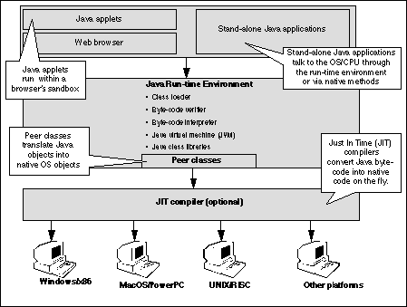
Java Platform Independence
JVM converts Bytecode to Machine code
compiled
executed
JAVA Source Code
JAVA Bytecode
Write Once, Run Everywhere
stored
JVM
class files
resides
server / local computer
Notes:
Java implementations typically use a two-step compilation process. Java source code is compiled down to bytecode by the Java compiler. The bytecode is executed by a Java Virtual Machine (JVM). JVM use a technique called JIT compilation to compile the bytecode to native instructions understood by hardware CPU on the fly at runtime.
SDJ Lecture 4 : Objects_Intro_pt1
© Swinburne or © Pearson Education, IncA Bayley

Slide 31
JVM
For each platform a different JVM is required. Mac computers need a different JVM, Linux machines need a different JVM and Windows machines have their own JVM. The same bytecode provided to these different jvms is converted to respective machine code and generates same results.

Slide 32
Java JDK
Java development kit or JDK comes with java compiler, libraries and other tools
The java compiler compiles a source code into bytecode
The javac command is used to compile a source code into bytecode
In order to run the bytecode a jvm is needed. The JVM is activated by calling java followed by bytecode file

Slide 33
Java runtime
A computer may have java runtime without having JDK
A java runtime has JVM and libraries but no compiler
In order to check if Java runtime is installed you type java –version at command prompt
In order to check if java compiler is installed, you may need to check the JDK directories
Java compiler is usually installed at a location similar to C:\Program Files\Java\jdk1.8.0_202\bin

Slide 34
Back to Class v Object
A CLASS (in most cases) defines the design
  But, one class will be used to start the program running
  Classes can have methods and variables
  Are designed and coded before we run our programs
An OBJECT is one instance of a class
  Are created as we need them in our program
  Are based on a class
  Different objects of one class may start off identical or differ because of their construction
  Methods can change the state of an object
Notes:
static in lec 4
SDJ Lecture 4 : Objects_Intro_pt1
© Swinburne or © Pearson Education, IncA Bayley

Slide 35
UML notation
Objects
Class
Account
-owner: String
-amount: double
+getBalance(): double
+credit(): int
+debit(): int
JhonAccount: Account
-owner=“Jhon”
-amount=5000.00
Attributes (Variables)
SamAccount: Account
-owner=“Sam”
-amount=7000.00
Operations (methods)
Notes:
SDJ Lecture 4 : Objects_Intro_pt1
© Swinburne or © Pearson Education, IncA Bayley

Slide 36
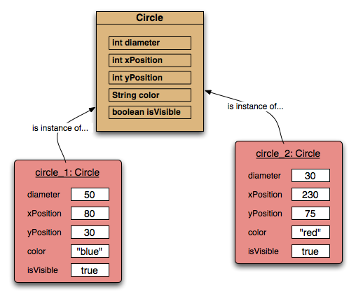
Two circle objects
(Instances of the Circle class)
Slide supplied by Barnes and Kolling

Slide 37
Basic class structure
public class ClassName
{
Attributes (Variables)
Constructors
Methods
}
The contents of a class (members)
public class TicketMachine
{
Further details omitted.
}
A sample class declaration
Notes:
SDJ Lecture 4 : Objects_Intro_pt1
© Swinburne or © Pearson Education, IncA Bayley
A Bayley
Train stations often provide ticket machines that print a ticket when a customer inserts the correct money for their fare. Consider defining a class that models something like these ticket machines.

Slide 38
Access level (visibility) modifiers
Members of a class can be …
  Public – You can access from anywhere
  Protected – You can access from sub classes through inheritance (discussed later)
  Private – You can access only within the class
Notes:
A package name is the same as the directory (folder) name which contains the .java files.
Package declaration: The first statement, other than comments, in a Java source file, must be the package declaration.
package illustrator;
public class Circle{
//class body
}
SDJ Lecture 4 : Objects_Intro_pt1
© Swinburne or © Pearson Education, IncA Bayley

Slide 39
Attributes (Variables in a class)
A place in memory that can have their values changed during the program’s execution are called variables
Attributes are what the object should know. They are specified as variables in a class.
Variables that store values for an object are known as instance variables (Fields)
count
20
public class TicketMachine
{
private int price;
private int balance;
private int total;
Further details omitted.
}
data type
Visibility (access) level modifier
variable name
private int price;
Notes:
SDJ Lecture 4 : Objects_Intro_pt1
© Swinburne or © Pearson Education, IncA Bayley
A Bayley
Ticket machines work by customers “inserting” money into them and then requesting a ticket to be printed.
price stores the fixed price of a ticket;
balance stores the amount of money inserted into the machine by a user prior to asking for a ticket to be printed;
total stores the total amount of money inserted into the machine by all users since the machine object was constructed (excluding any current balance). The idea is that, when a ticket is printed, any money in the balance is transferred to the total.

Slide 40
Variables
Data Types
Primitives
Non-primitives (Objects)
E.g. String (zero or more characters enclosed within “”)
Numeric
int
short
long
byte
float
double
Non- Numeric
char
boolean
TYPE NAME | KIND OF VALUE | MEMORY USED | SIZE RANGE
boolean | True or false | 1 byte | Not Applicable
char | Single Character | 2 bytes | Common Unicode Characters
byte | Integer | 1 byte | -128 to +127
short | Integer | 2 byte | -32768 to 32767
int | Integer | 4 byte | -2147483648 to 2147483647
long | Integer | 8 byte | -9223372036854775808 to 9223372036854775807
float | Floating-point number | 4 bytes | 3.4e-38 to 3.4e38
double | Floating-point number | 8 bytes | -1.7e308 to 1.7e308
  Read more
Notes:
Java has basic types to store whole numbers, floating point numbers, true or false, characters etc. These basic types are knows as primitives.
.
SDJ Lecture 4 : Objects_Intro_pt1
© Swinburne or © Pearson Education, IncA Bayley

Slide 41
Variables
Variable Names
  Java is case sensitive (e.g: “A” is different than “a”)
  How they are declared is how they are used throughout the program.
  Rules for variable names:
    May be any length
    Must start with a letter, _ , or $
    Must not contain spaces, tabs or special characters
    Must not use dash/ hyphen/ minus sign
    Must not be keywords (such as: main, void, public)
  Conventions for variable names:
    First letter should be lowercase
    Each new word starts with a capital (e.g. heightInMetres)
    All names should be meaningful

Slide 42
Declaring variables
A variable must be declared before used
When declaring instance variables (variables that store object data)…
  Making them public or private is a design trade off
  int count;
  public char capitalC;
  private byte b;
Note, use of public or private
We should keep our data private!

Slide 43
Initializing Variables
Setting the first value of the variable is initializing.
It is good practice to initialize variables.
We know what we are starting with.
An error can be raised if the variable doesn't have a value before it is used.
public class TicketMachine
{
private int price = 100;
private int balance = 0;
private int total = 0;
……
……
}

Slide 44
Constructors
Class Declaration
Constructors initialize an object.
They have the same name as their class.
They store initial values into the fields.
They often receive external parameter values for this.
It is not mandatory to write a constructor
  Fields are automatically initialized to zero, false or null
  However it’s good practice to do so
Constructor
public class TicketMachine
{
  public TicketMachine(int ticketCost)
  {
  price = ticketCost;
  balance = 0;
  total = 0;
  }
  ……
  ……
  ……
  ……
}
Notes:
SDJ Lecture 4 : Objects_Intro_pt1
© Swinburne or © Pearson Education, IncA Bayley
A Bayley

Slide 45
No constructor???
public class TicketMachine
{
private int price = 1;
private int balance = 0;
private int total = 0;
public void setPrice(int tickCost)
{
price = tickCost;
}
No constructor!?
Further details omitted.
}
Inferior design – constructors are good !
Notes:
SDJ Lecture 4 : Objects_Intro_pt1
© Swinburne or © Pearson Education, IncA Bayley
A Bayley
No constructor? Compiler creates one automatically. It has no parameter. You could call this the “default constructor” but actually “default constructor” means a constructor without parameter whether written by you or not.
So we can create objects. They will have price $1. We might forget to call setPrice.
Of course if we didnt have ‘= 100’ then we would be worse off!
Having a constructor that takes parameters for necessary attribute values is good – reminds programmer about these.
final – the last value given to it. Normally constants are static and may be public or private – later.

Slide 46
Expressions
An expression is a series of variables, operators and method calls (constructed according to the syntax of the language) that evaluates to a single value.
Expression perform the work of a java program.
Expressions are used to :
  Compute (eg. totalprice = productcost + shippingcost)
  Assign values to variables (eg. count = 10)
  Help control the execution flow of a program
  eg. if(count <10)
  count++;
Notes:
SDJ Lecture 4 : Objects_Intro_pt1
© Swinburne or © Pearson Education, IncA Bayley
A Bayley

Slide 47
Constants
Used for data that will never change during execution.
Variables that are assigned only once and cannot be changed afterwards
Benefits:
  It can't be changed accidently
  Attached a meaningful name to a value
  Only a single edit is needed if a different value is to be used
  By convention, constants are named in UPPERCASE
  Typically constants are declared static (if it has only one value)
public static final double PI = 3.14159;
Notes:
Note: If the constant might have different value for each object, for example the value depends on the creation time of the object, it should not be declared static.
SDJ Lecture 4 : Objects_Intro_pt1
© Swinburne or © Pearson Education, IncA Bayley

Slide 48
Methods
Methods implement the behavior of objects
It is a named block of code that can be called (or invoked) one or more times in an application
public class TicketMachine
{
private int price = 100;
public int getPrice()
{
return price;
}
public void setPrice(int tickCost)
{
price = tickCost;
}
………
………
}
Methods

Slide 49
Methods
Visibility (access) Modifier
Note: A method signature is the method name and the number and type of its parameters and their order.
Parameters
Return type
Method Header
public void myMethod(int yearStarted, String studentName)
{
boolean result = true;
char capitalC = 'C';
byte b = 100;
short s = 10000;
int i = 100000;
…………
…………
}
Method Body
Local variables (located inside methods)
Notes:
In the text book, method signature is defined as the header of the method. But this is not the best definition for a method signature. Method signature does not include the return type of a method.
SDJ Lecture 4 : Objects_Intro_pt1
© Swinburne or © Pearson Education, IncA Bayley

Slide 50
Method Calls
A method call supplies values—called arguments—for each of the method’s parameters.
myMethod(2017, “Sam”);
public void myMethod(int yearStarted, String studentName)
{
…………
…………
}

Slide 51
Accessor methods
Accessors provide information about an object.
return type
Access level modifier
method name
parameter list (empty)
public int getPrice()
{
return price;
}
return statement
start and end of method body (block)
Notes:
SDJ Lecture 4 : Objects_Intro_pt1
© Swinburne or © Pearson Education, IncA Bayley
A Bayley

Slide 52
Mutator methods
Have a similar method structure: header and body.
Used to mutate (i.e., change) an object’s state.
Achieved through changing the value of one or more attributes.
  Typically contain assignment statements.
  Typically receive parameters.
    eg “set” methods
  Often do not return a result
Notes:
SDJ Lecture 4 : Objects_Intro_pt1
© Swinburne or © Pearson Education, IncA Bayley
A Bayley

Slide 53
Mutator methods
visibility modifier
return type
method name
parameter
public void insertMoney(int amount)
{
balance = balance + amount;
}
assignment statement
assignment operator
field being mutated
Or
balance += amount;
Notes:
SDJ Lecture 4 : Objects_Intro_pt1
© Swinburne or © Pearson Education, IncA Bayley
A Bayley

Slide 54
Printing from methods printTicket method…
public void printTicket()
{
// Simulate the printing of a ticket.
System.out.println("##################");
System.out.println("# Ticket");
    System.out.println("# " + price + " cents.");
    System.out.println("##################");
    System.out.println();
  // Update the total collected by this machine
  total = total + balance;
  // Clear the balance.
  balance = 0;
}
Is this correct behaviour?
Notes:
SDJ Lecture 4 : Objects_Intro_pt1
© Swinburne or © Pearson Education, IncA Bayley
A Bayley

Slide 55
printTicket method improved…
public void printTicket()
{
  if(balance >= price)
  {
    // Print the ticket
    ...
    // Update the total collected with the price.
    total = total + price;
    // Reduce the balance by the price.
    balance = balance – price;
    ...
  }
  else
  {
  System.out.println("You must insert at least:"+ (price – balance) + " cents.");
  }
}
Notes:
Print a ticket if enough money has been inserted, and reduce the current balance by the ticket price. Print an error message if more money is required.
SDJ Lecture 4 : Objects_Intro_pt1
© Swinburne or © Pearson Education, IncA Bayley

Slide 56
For reference: Java Reserved words
abstract, boolean, break, byte, (byvalue),
case, (cast), catch, char, class, (const), continue,
default, do, double, else, extends, final, finally, float, for, (future), (generic), (goto),
if, implements, import, (inner), instanceof, int, interface,
long, native, new, null, (operator), (outer),
package, private, protected, public, (rest), return,
short, static, super, switch, synchronized,
this, throw, throws, transient, try, (var), void, volatile, while
[Words like (const) are not in use.
You will learn almost all the others during the semester!]

Slide 57
A simple Java Program
  //HelloWorld.java
  //First Java Program
  public class HelloWorld
  {
  public static void main(String[] args)
  {
  System.out.println("HelloWorld Java!");
  }
  }
Notes:
SDJ Lecture 4 : Objects_Intro_pt1
© Swinburne or © Pearson Education, IncA Bayley

Slide 58
A simple Java Program
Save the file with the same name as the class name with a .java extension.
HelloWorld.java
Compile the program (javac <filename>.java).
javac HelloWorld.java
(Creates HelloWorld.class that contains bytecode)
Run the program (java <classfilename>).
  java HelloWorld
  (interprets byte code)

Slide 59
A simple Java Program
public class HelloWorld
{
Class declaration HelloWorld
  Every program in java has at least one class declaration defined by the programmer (programmer-defined classes / user-defined classes)
  class
    Keyword / reserved word
    Lowercase letters
  Class name
    Capital first letter for every word in class name
    Case sensitive - uppercase and lowercase letters are different

Slide 60
A simple Java Program
public static void main(String[] args)
{
A part of every java application
Main with parenthesis – indicates it is a building block called method
  Java classes contains one or more methods
  Exactly one of those methods must be called main and defined
void – the method will perform a task but will not return any information when it completes its task
String[] args – is an array of string variables which will be input in the command line

Slide 61
A simple Java Program
System.out.println(“Hello World java!");
Class System is defined in the standard package java.lang
A statement
System.out object is known as the standard output object.
Instructs computer to perform an action
  display information in the command window from which it executes.
  print a string of characters / character string /message / string literal
  white spaces within “ ” not ignored
Notes:
In Windows, the command window is the Command Prompt. In UNIX/Linux/Mac OS X, the command window is called a terminal window or a shell.
SDJ Lecture 4 : Objects_Intro_pt1
© Swinburne or © Pearson Education, IncA Bayley

Slide 62
A simple Java Program: output
Contents of variables can be output to the console window using
  System.out.print()
  System.out.println()
More than one value can be output by using the concatenator, +:
  System.out.println("Count is: " + count + " items");
  System.out.print("Answer is: ");
  System.out.println(ans);
Any type – automatically converted to a string
println() and print() have overloadings (versions) for any type –
any number, boolean, String, any object

Slide 63
A simple Java Program: Formatted output
For writing double values and all output in tables ("tabular")
we need to control field widths and decimal places.
  double x = 0.09999978;
  System.out.println("x = $" + x); x = $0.09999978
System.out have printf which can be used to format output
  System.out.printf("x = $%5.2f \n", x); x = $ 0.10
  int n = 5;
  System.out.printf("x = %4.1f n = %d %nGoodbye", x, n);
  x = 0.1 n = 5
  Goodbye
%5.2f will print maximum 5 digits of the number. If the number of digits is not enough, it will be padded.
prints maximum 2 decimal digits
%n is for newline -- escape sequence \n is less portable
Notes:
% character acts as a placeholder.
%d : will print a decimal integer as it is
%f : will print the number as it is.
%6f : will print the number as it is. If the number has less than 6 digits, the output will be padded on the left.
%.6f : will print maximum 6 decimal digits of the number.
%5.2f : will print maximum 5 decimal digits of the number. If the number of digits is not enough, it will be padded.
SDJ Lecture 4 : Objects_Intro_pt1
© Swinburne or © Pearson Education, IncA Bayley

Slide 64
A simple Java Program
  public class FairwellCruelWorld
  {
    public static void main (String[] args)
    {
    System.out.print(“Good bye ");
    System.out.println(args[0] + “ It’s a cruel cruel world!”);
    }
  }
Run>>
java FairwellCruelWorld Peggy Sue
Output>>
Peggy It’s a cruel cruel world!
java.exe creates the array and passes it to main()

Slide 65
Program style and Java Doc
Comments – to document programs and improve program readability
  single-line comment
  multiple line comment
    Block comments
    Documentation comments
White spaces – for readability
  blank lines, space and tab characters
Indentation
Braces
//HelloWorld.java
//First Java Program
/* This is a block comment
…………………………………………
End of comment
*/
/* * This is documentation
comment………………………
End of comment
*/

Slide 66
Example: comments and style
javadoc comment start
/**
* First example, an application.
*/
public class HelloWorld {
    /**
    * Execution starts here
    * @param args ignored
    */
    public static void main (String[ ] args){
    System.out.println("Hello Students");
    }
}
Alternative placement of open brace
Essential
parts
javadoc is a utility that creates HTML documentation from *.java files, using documentation comments.

Slide 67

Reading
Read BlueJ chapter 2
Notes:
SDJ Lecture 4 : Objects_Intro_pt1
© Swinburne or © Pearson Education, IncA Bayley

Slide 68
References
http://docs.oracle.com/javase/tutorial/getStarted/application/index.html
http://docs.oracle.com/javase/tutorial/java/nutsandbolts/datatypes.html
Java 6 API
  http://docs.oracle.com/javase/6/docs/api/
Java 7 API
  http://docs.oracle.com/javase/7/docs/api/
Java 8 API
  https://docs.oracle.com/javase/8/docs/api/

